Slide 1
529 Data Analytics
October, 2016
University Rank Data –Regression Analysis
Dinesh Kawatia

Slide 2
Table of Content
Business Scenario
Business Objective
Times University Ranking Data
Data Processing Steps
Exploratory Data Analysis Results
Regression Modeling Results
Conclusions

Slide 3
Business Scenario: Variables Influencing International Students
University administration wants to increase the number of international students which enrol in there university. The research unit is being given the task to identify key parameters which influence the number of international students who enrol for a particular university. This will help university identify areas which can be focussed and appropriate actions can be taken to increase the number of international students.

Slide 4
Business Objective
Increase the number of international students who enrol in the university.
This will be addressed by building a model to identify which parameter influences the increase or decrease in number of international students
The parameters analysed are
  World Rank
  International Student Per cent(ISP)
  International Score
  Teaching Score
  Research Score
  Citations Score
  Income Score

Slide 5
Selected Data:
University Ranking Data Details
University dataset to be used for this analysis is taken from the below link-
https://www.kaggle.com/mylesoneill/world-university-rankings
The Times Higher Education World University Ranking is widely regarded as one of the most influential and widely observed university measures. Founded in the United Kingdom in 2010, it has been criticized for its commercialization and for undermining non-English-instructing institutions
File Name-timesData.csv
Time period of dataset- From 2011 to 2016. Data used in the current analysis is for the year 2011-2016

Slide 6
Selected Data Variables(X/Y)
Variable | X(Predictor) | Y (Response)
Continuous | 1.World Rank 2.International Score(staff, students and research) 3.Teaching Score(the learning environment) 4.Research Score (volume, income and reputation) 5.Citations Score (research influence) 6.Income Score (knowledge transfer) | 1.International Student Per cent
Categorical | None | None

Slide 7
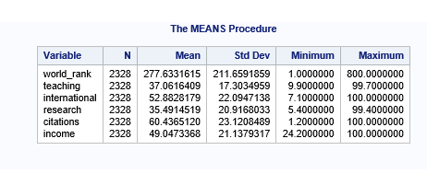
Data Processing Steps:
There are 1402 number of observation which has World Rank defined in a range e.g. 201-225 and the remaining 1201 observations have specific rank numbers
For this analysis the rank defined as range are updated to highest value defined in the range e.g. 201-225 is updated to 225
Data has been filtered to remove the records for which there is no value in the identified list of predictor variables
Data for the year 2011 to 2015 has been only considered in the analysis
Total number of observation for the year with no null values for the identified variables is 2328
There are no negative values in the identified variables
Data cleaning was performed in excel before importing in SAS

Slide 8
Exploratory Data Analysis : Scatter Plot International Student Percent(ISP) Vs. Predictor Variables
Findings from Scatter Plot
International Student Per cent has negative linear relationship with World rank till rank 200.
International Student Per cent(ISP) has a strong linear relationship with International score
Research and Teaching score exhibits similar pattern
Citation is more skewed towards higher value and concentrated towards lower value
Income does not represent linear relationship
Refer the scatter plot in the next slide

Slide 9
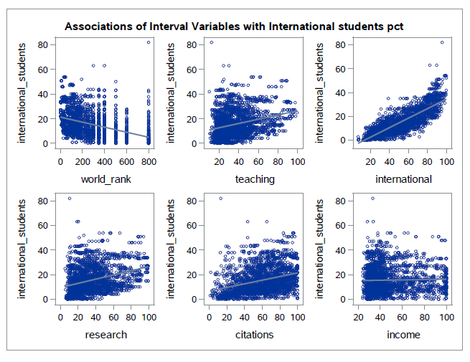
Exploratory Data Analysis:
International Student Percent(ISP) Vs. Predictor Variables

Slide 10
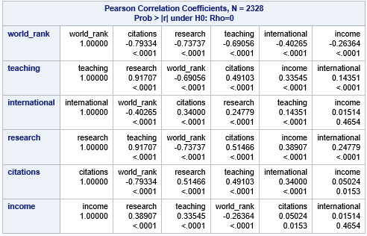
Exploratory Data Analysis :
Correlation in the Predictor Variables

Slide 11
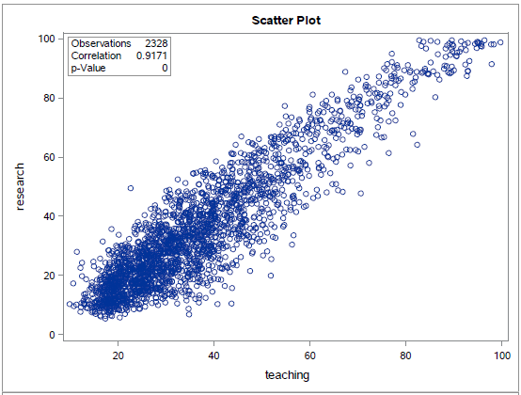
Exploratory Data Analysis:
Correlation in the Predictor Variables
Teaching and Research has strong positive correlation hence one of the variable should be excluded in the model

Slide 12
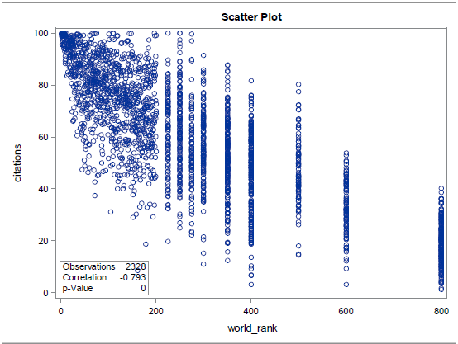
Exploratory Data Analysis :
Correlation in the Predictor Variables
World Rank has a strong negative correlation with citations (-0.79334),
research(-0.73737) and teaching(-0.69056)
Income has weak correlation with other variable

Slide 13
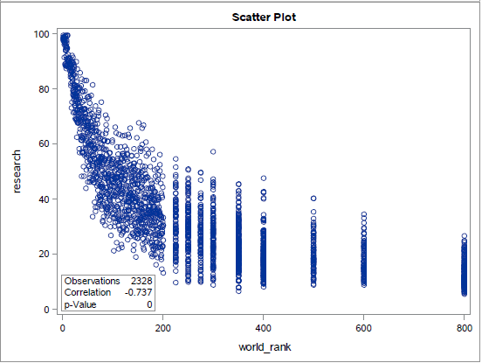
Exploratory Data Analysis Results :
Correlation in the Predictor Variables
World Rank has a strong negative correlation research(-0.73737) and teaching(-0.69056)

Slide 14

Correlation of International Student Percent(ISP)(Response) Vs. Predictor Variables
International Students Per cent(ISP) cent has-
Strong correlation with international score with p value <0.0001 and correlation coefficients of 0.81790
The smaller p-value indicates a stronger evidence against null hypothesis, so rejected the null hypothesis i.e. there is no variation that exist between ISP and International score, hence this variable can have stronger influence over ISP.
Weak negative correlation with World ranking(Check the impact on Adjusted R2
in the model to understand the influence on ISP)
Weak positive correlation with citations, research and training(Check the impact
on Adjusted R2 in the model to understand the influence on ISP)
Income does not any significant relation due to its correlation value closer to 0
hence can be ignored in model
Both response and predictor variable are Continuous hence will fit Regression Model

Slide 15
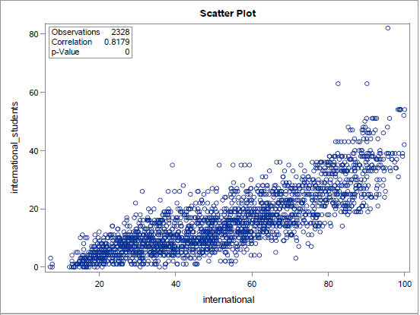
Correlation of International Student Percent(ISP) Vs. International Score

Slide 16
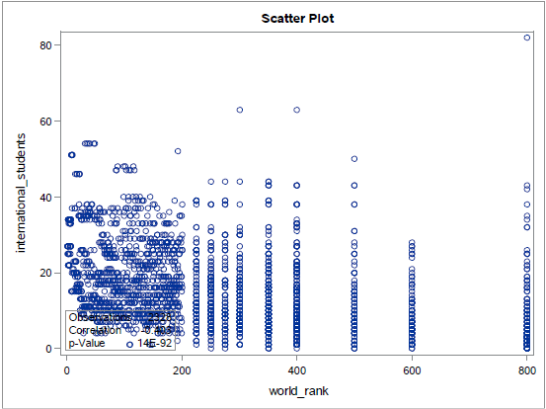
Correlation of International Student Percent(ISP) Vs. World Rank

Slide 17
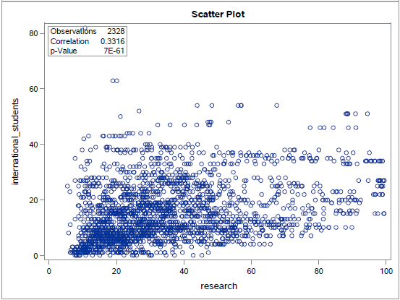
Correlation of International Student Percent(ISP) Vs. Research Score

Slide 18
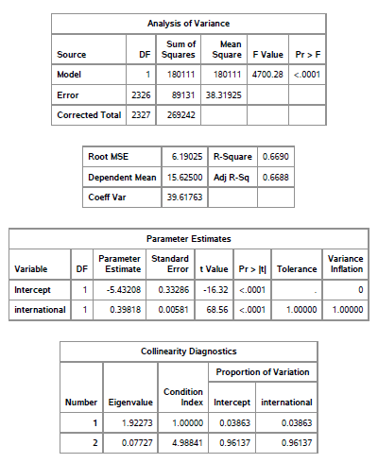
Regression Modeling-Option 1
Model Fit Check for ISP Vs. International Score
Run the regression analysis model with ISP Vs. International Score
The F-test is statistically significant, which means the model is significant.
Adjusted R-squared is 0.6688 means that approximately 67% of the variance of ISP is accounted for by the model, here International Score.
The Error and Corrected total do not have much difference, indicates a better fit of the model.
Significant fit indicates a good relationship between the response and the predictor variables and the equation to contain less error factor.
The coefficient of International score is 0.39818 which means a increase in International score by 1 unit, the ISP values can be expected to increase by 0.039818.

Slide 19
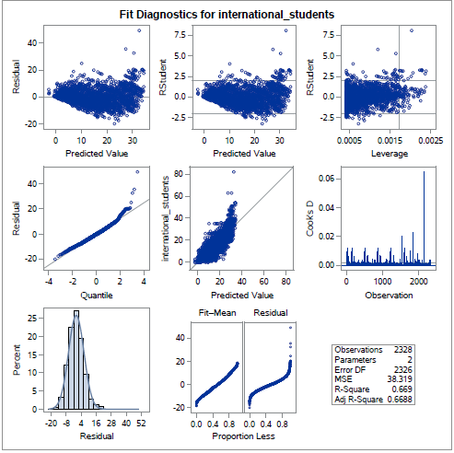
Regression Modeling-Option1
Model Fit Check for ISP Vs. International Score Cont.
The data is normally distributed
ISP variable has significant portion of variation in the model, with little residual variation. That is, there is variation of ISP which is influenced by other variables with no unexplained error(Fit-mean ,residual plot)
ISP = -5.43208+0.39818(International Score)

Slide 20
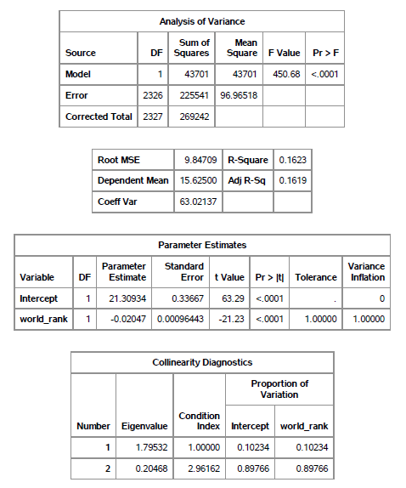
Regression Modeling-Option 2
Model Fit Check for ISP Vs. World Rank
Run the regression analysis model with ISP Vs. World Rank
The F-test is not statistically significant since the value of F is lower compared to the International Score
Adjusted R-squared is 0.1619 means that approximately 16% of the variance of ISP is accounted for by the model, here World Rank.
The coefficient of World Rank is -0.02047 which means a increase in World Rank by 1unit, the ISP values can be expected to decrease by -0.02074 which is negligible hence World Rank does not have does not have strong influence in predicting ISP
ISP=21.30934-0.02074(World Rank)

Slide 21
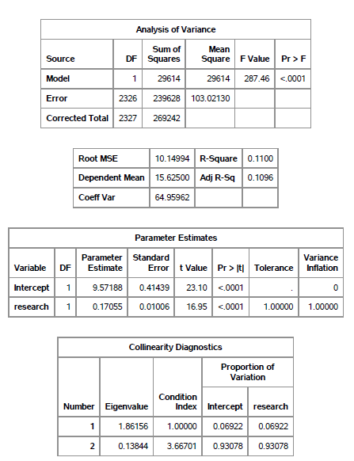
Regression Modeling-Option 3
Model Fit Check for ISP Vs. Research
Run the regression analysis model with ISP Vs. Research
The F-test is not statistically significant since the value of F is lower compared to the International Score
Adjusted R-squared is 0.1096 means that approximately 10% of the variance of ISP is accounted for by the model, here Research Score.
The coefficient of Research score is 0.17055 which means a increase in Research score by 1 unit, the ISP values can be expected to increase by 0.17055 hence a weak influence in predicting ISP
ISP= 9.57188 + 0.17055(Research)

Slide 22
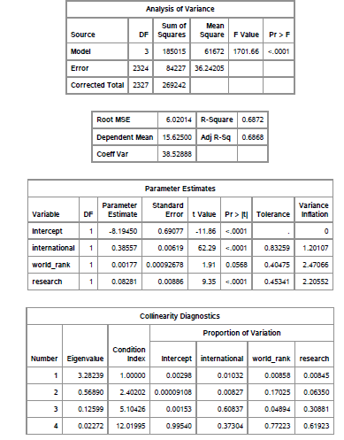
Regression Modeling –Option 4
Model Fit Check for ISP Vs. International Score, World Rank and Research Score
Run the regression analysis model with ISP Vs. International Score, World Rank, Research
The F-test is statistically significant, which means the model is significant.
Adjusted R-squared is 0.6868 means that approximately 68% of the variance of ISP is accounted for by the model, here International World Rank and Research Score.
ISP = -8.19450 + 0.38557(International) +0.00177(world_rank) + 0.08281(research)

Slide 23
Regression Modeling Results:
Comparison between models
Parameters | Model Option 1 | Model Option 2 | Model Option 3 | Model Option 4
Variables Taken | International Score | World Rank | Research | International Score, World Rank and Research
Pr Value | Low P values <.0001 | Low P values <.0001 | Low P values <.0001. | Low P values <.0001.
Adjusted R Squared | 0.6688 | .1619 | .1096 | 0.6868
F-Statistics | 4700.28 | 450.68 | 287.46 | 1701.66
Equation | ISP = -5.43208+0.39818(International Score) | ISP=21.30934-0.02074(World Rank) | ISP= 9.57188 + 0.17055(Research) | ISP = -8.19450 + 0.38557(International) +0.00177(world_rank) + 0.08281(research)
From the Table above it is clear that combination of International Score World Rank and Research has the strong influence on International Students Percent

Slide 24
Conclusions:
Combination of International Score, World Rank and Research has the strong influence on International Students Percent International.
The regression equation for predicting is ISP = -8.19450 + 0.38557(International) +0.00177(world_rank) + 0.08281(research)
In order to increase the number of International students the University administration department needs to focus primarily on improving the International score/outlook which comprises of International to domestic student ratio, International to domestic staff ratio and International collaboration

